Slide 1
An Analysis of the Popularity of Facebook News Posts
By: Thanika Reddy

Slide 2



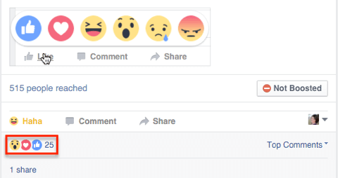




Introduction
Some posts on social media become more popular than others
What factors lead to an increase in popularity?
Does the sentiment of a post affect how quickly it gets comments?
Do posts on weekends get more activity than posts on weekdays? Does the time of post creation matter?

Slide 3
Data and Preprocessing
Derived features
Day of post creation (7 binary features) Time (on a certain day) of post creation (4 binary feature) Average number of shares per second Average number of "angry", "haha", "like", "love", "sad" and "wow" reactions per second Sentiment, Positivity, Negativity and Neutrality Minutes until a post gets its first comment Minutes until a post gets its 100th comment
Facebook News Dataset
~20K posts from 83 various news organizations & personalities , last 250 page posts.
Each post has up to 100 comments for a total of ~1,000,000 comments.
Features representing each post | Features representing each comment
Post creation time Post scrape time Description Link Contents of the post, Page ID Post ID, Number of "angry", "haha", "like", "love", "sad" and "wow" reactions Number of shares the post has | Parent post ID Comment creation time Name and ID of the user who created the comment Contents of the comment.
VADER (for sentiment)

Slide 4
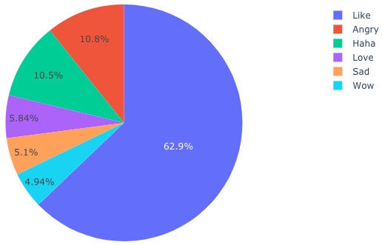
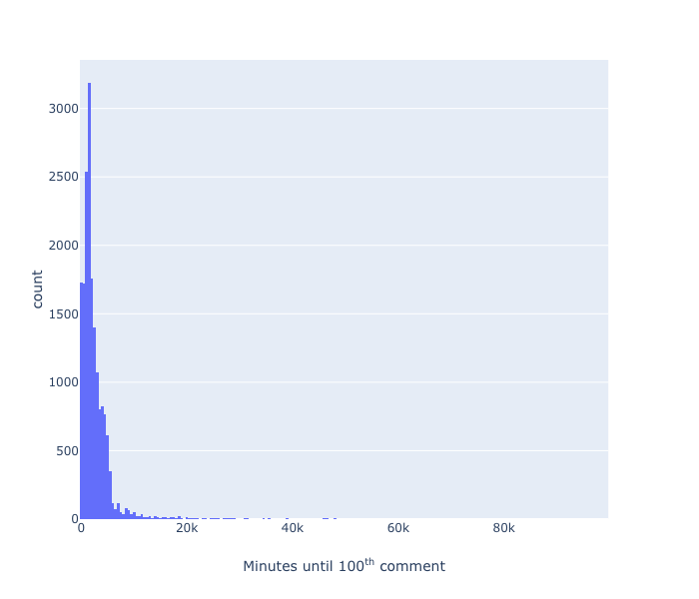
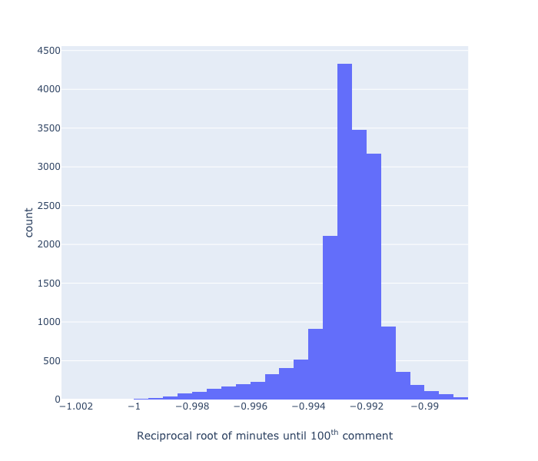
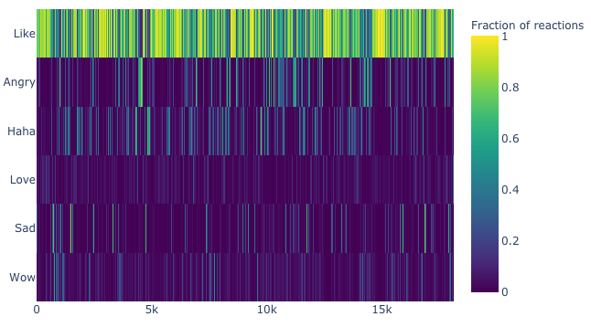
Heavily skewed data
80.9% of the posts get their 100 comments within 67 hours.
Most other features have similarly skewed distributions
A log transform was not powerful enough for some features. The reciprocal root transform was then used, with a different fractional power for each feature
“Likes” are the most frequently occurring type of reaction

Slide 5
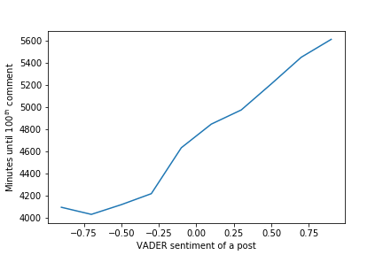
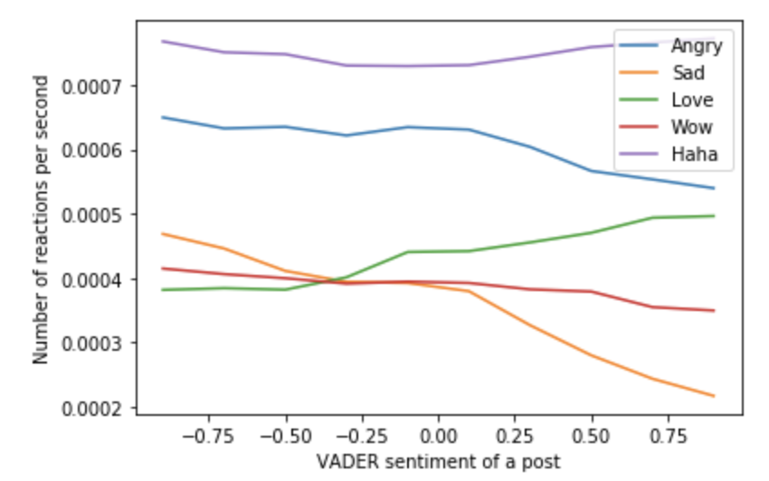
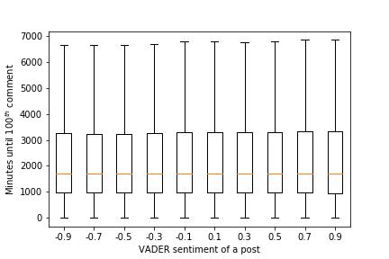
Potential relationships
between features
Posts with positive sentiment take longer to get 100 comments, i.e. they seem to be less popular
This pattern seems to be observed only for the 20% of posts that get their 100th comment after 67 hours
The number of reactions (of a certain type) received by a post per second indicate the sentiment of a post.

Slide 6
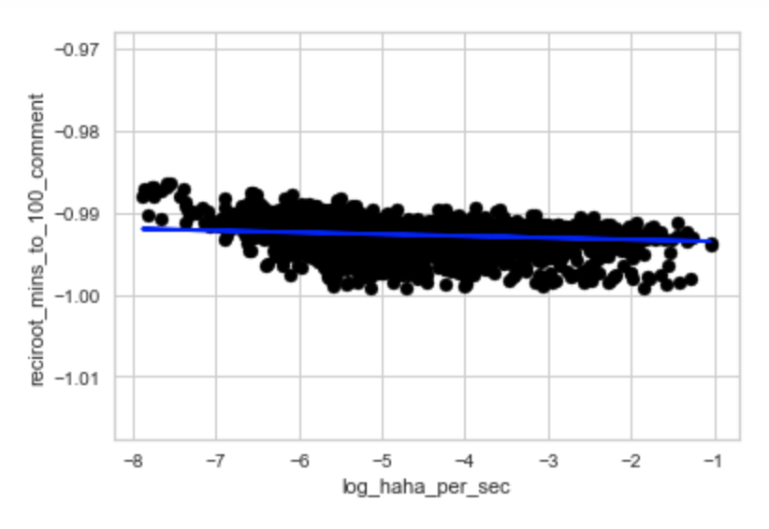
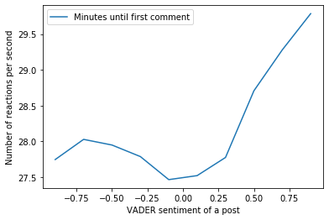
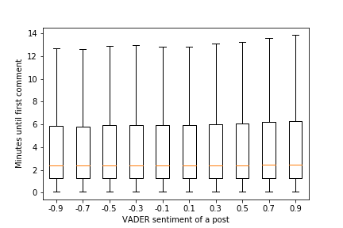
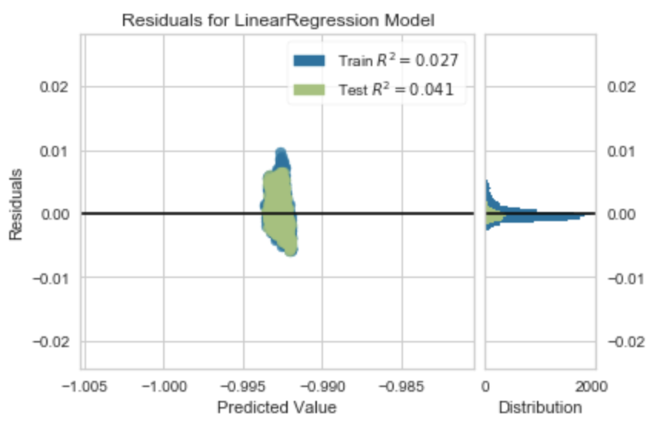
Potential relationships between features
Fitting univariate linear regression between the time until 100th comment and each other feature

Slide 7
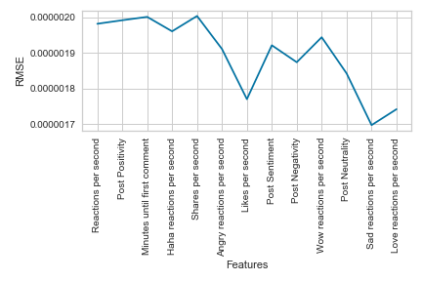
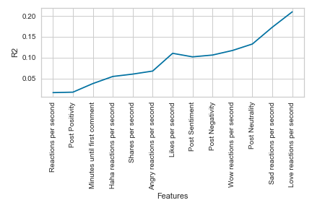
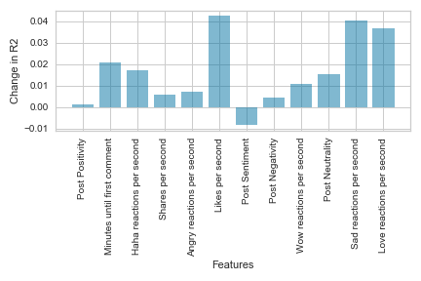
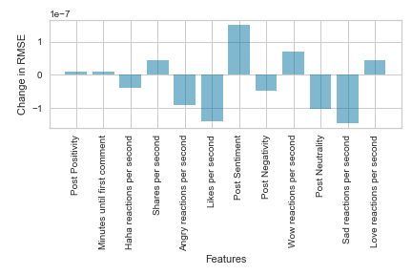
Multivariate Linear Regression
Add features one at a time, observe the change in the R² score, pick the six features with that increase the R² score the most over 100 iterations:
Log-scaled number of "love", "sad", "like" and "wow" reactions per second,
Reciprocal root transformed number of reactions per second,
Minutes until a post gets its first comment

Slide 8
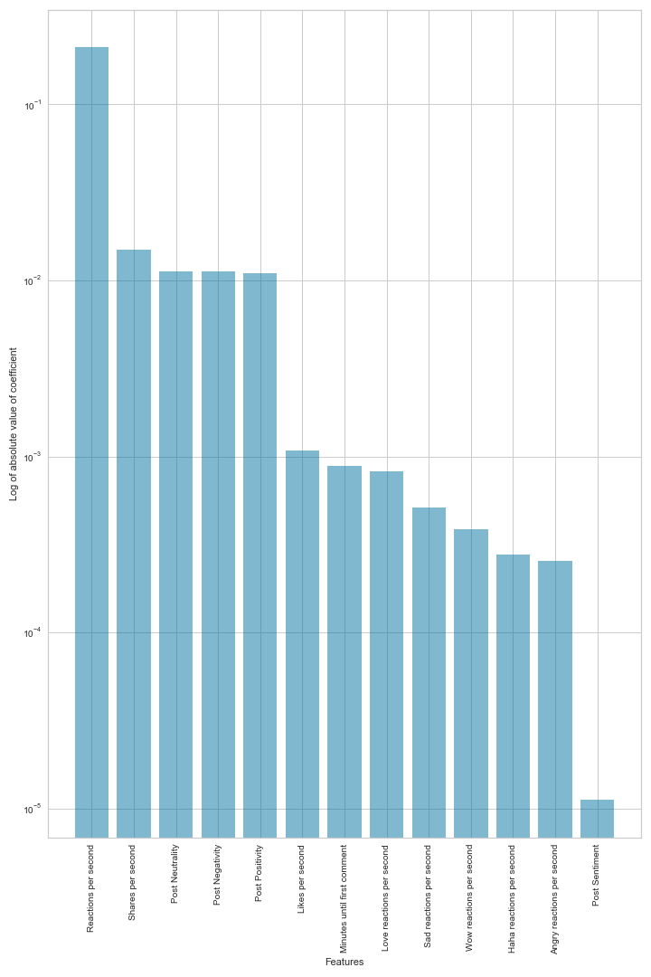
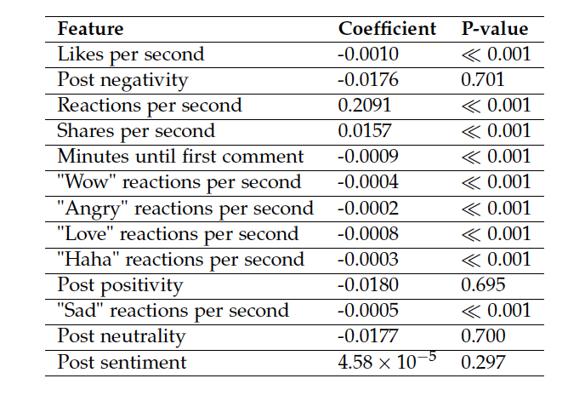
Multivariate Linear Regression
The number of reactions received by a post per second has the largest coefficient, followed by shares per second, positivity, negativity and neutrality.

Slide 9
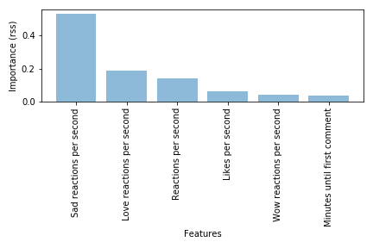
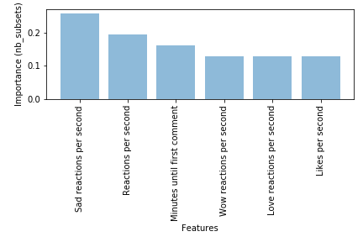
MARS and SVR
For SVR, a grid search was performed over
three kernels (linear, RBF and polynomial),
four values of C (0.1, 1, 100, 1000), eleven values
of e (0.0001, 0.0005, 0.001, 0.005, 0.01, 0.05,
0.1, 0.5, 1, 5, 10) and seven values of g (0.0001,
0.001, 0.005, 0.1, 1, 3, 5).
The RBF kernel with
values C = 0.1, g = 0.1 and e = 0.0001 performed
the best.
The MARS model chooses both negative sentiment and popularity of the news page/ its followers to be the most predictive.
This is unlike multivariate linear regression, which chooses only the number of reactions per second to be the most predictive (with no sentiment).

Slide 10
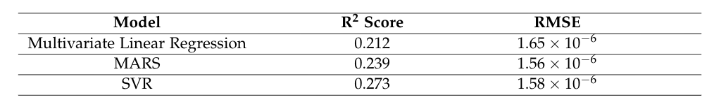
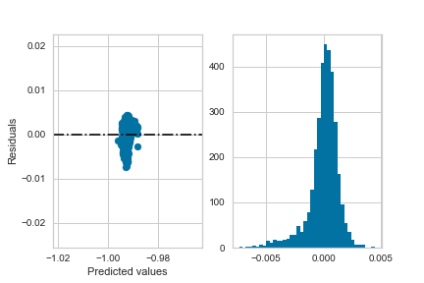
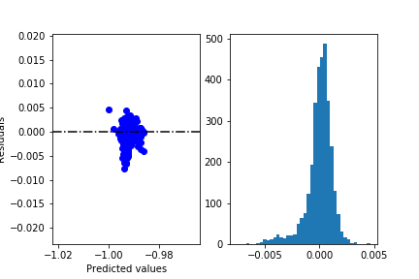
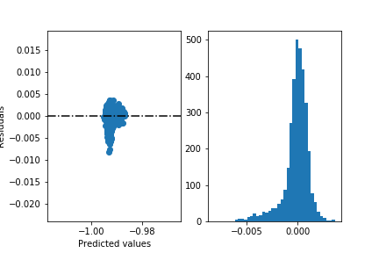
Comparison of model performance
MARS improves the R² score by 12.7% over
Multivariate Linear Regression
SVR further improves it by 14.2%
MARS reduces the RMSE by 5.4%
Residuals for multivariate linear regression
Residuals for MARS
Residuals for SVR
The residuals become progressively more heavy tailed.

Slide 11
Thank you!

